Slide 1
VEHICLE UNLOCKING SYSTEM USING FACIAL RECOGNITION
Group 2
Ayushi Khare
Kunjal Agrawal
Aslaan mulla
Hiranmayee Sant
Atman Naik

Slide 2
TECHNOLOGIES USED
SOFTWARE- Coded in python, Multiple Libraries used for training the data
Hardware
-Raspberry Pi-4
-5 volt relay
-9v dc motor
-Raspberry pi camera
-9v battery
-Different connecting wires- jumper cables

Slide 3
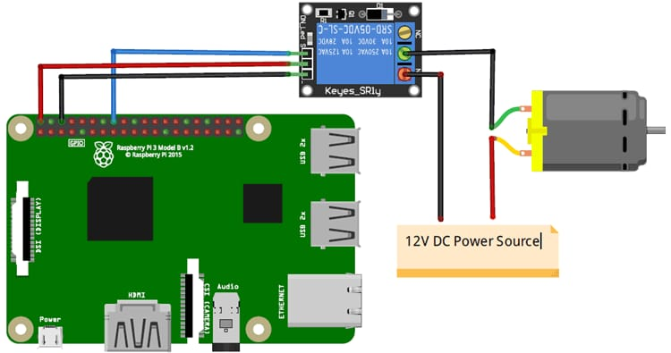
Circuit diagram

Slide 4
THANK YOU

